Slide 1
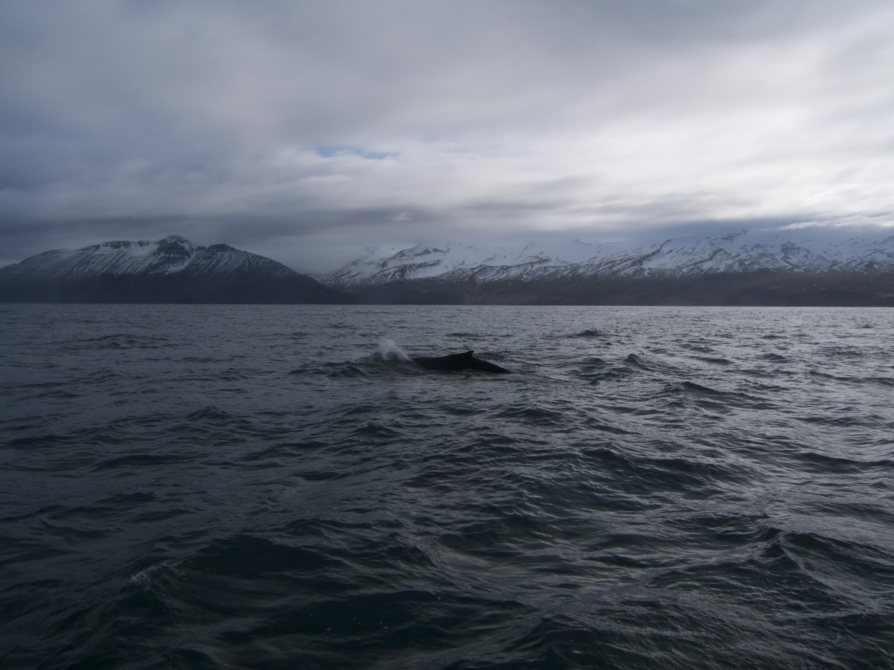
Hin Hoarau-Heemstra– Førsteamanuensis Nord Universitet hin.h.heemstra@nord.no
Betydningen av kunnskap og verdier ved innovasjon: eksempler fra hvalsafari

Slide 2
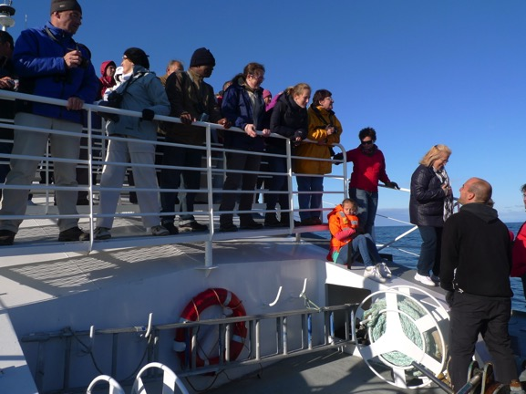
Hvalsafari som opplevelses produkt
Kom i kontakt med naturen,
Glem stress i daglig livet
Opplev landskap og dyreliv
  Er hvaler spesielt?
Report IFAW (2009):
  13 million whale-watchers
  119 countries and territories
  Generating total expenditure of $2.1 billion
  3300 operators
Hvem er kunden? Hvordan ønsker de være involvert? Hvorfor velger de Norge? Hva trenger naturen og hvalene?

Slide 3
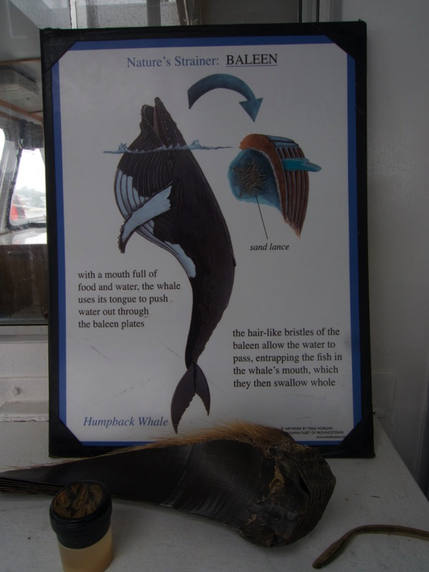
Innovasjon er nødvendig for hvalsafari-bedrifer
Glocal konkurranse: viktig å bli sett og å være annerledes
Naturen, dyr og vær er uforutsigbare
Å finne måter å kunne bruke investeringer hele året
Nye typer kunder og kulturer
Miljøbevissthet
Prisene på drivstoff
Nye regler og forskrifter
Klimaendringer

Slide 4
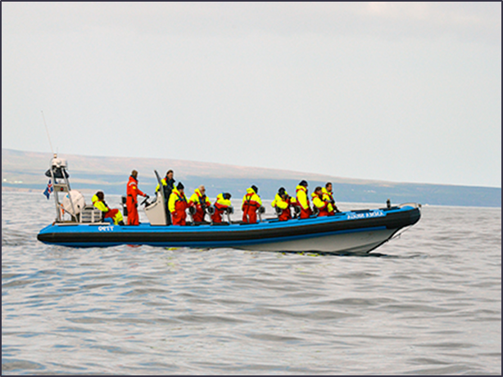
Eksempler av innovasjon i hvalsafari bedrifter
Product
  Mid night sun whale-watching
  Big whale-trip with fast Zodiac
  Whales and Sails
  Snorkling / Swimming with whales
Storytelling
  Who are we? Who are the whales?
Process
  More comfort: warm suits and sea-sickness pills for everybody
  New ways of finding whales with hydrophones
Management
  Environmental management system
Marketing
  Blogs; online booking systems; videos; social media etc.
Hvor finner bedriftene motivasjon og kunnskap til innovasjon?

Slide 5
Science and Industry: Sharing knowledge for Innovation (Hoarau and Kline, 2014)
The tourism experience as locus of knowledge sharing and value co-creation by those involved in the practice
By strategically reflecting upon knowledge acquired in practice, tourism innovators can incorporate this knowledge into innovation processes (Sundbo & Fuglsang, 2002).
Focus on the role of scientists as external source of knowledge in co-creation processes in tourism
Long term interaction, sharing tacit knowledge and building social capital between scientists and tourism businesses facilitates the absorption of research-based knowledge in tourism innovation
Model of innovation through co-creation
Notes:
Process of this paper (methodology and how we came to write it)

Slide 6
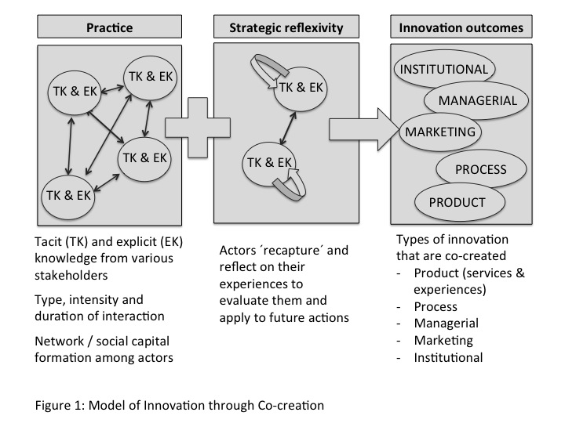
Notes:
Advancement of the concept of co-creation by including non-commercial for co-creating customer value and other tourism practices
Intensive, practice based interactions between tourism actors and researchers is beneficial for organizational learning and innovation
Knowledge is co-created in tourism practices. This knowledge is unique, inimitable and crucial for the development of tourism products and services
Model of innovation through co-creation

Slide 7
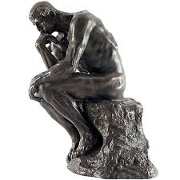
Hva er viktig for vellykket innovasjon?
Kunnskapsdeling (i praksis)
  Hvalsafari : interaksjon med turister
  Forskningsaktiviteter : samspill med forskere
  Møter, seminarer, sammenkomster etc .: samspill med ansatte
  Destinasjonsutvikling : samspill med aktørene i lokalsamfunnet
  Besøk kollegaer: se hva andre gjør med hvalsafari
  Politisk aktivisme: samspill med frivillige organisasjoner som IFAW, Bellona, Greenpeace etc.
Strategiske refleksjoner på ny lært kunnskap

Slide 8
Hva er viktig for vellykket innovasjon?
Authenticity
Values
Originality

Slide 9
Values and concern: drivers of innovation in experience-based tourism (Hoarau-Heemstra and Eide, 2016)
Discussion of how values & concern influence behavior of innovators and drive innovation processes
Demonstration and discussion of how values and concerns motivate tourism businesses in a certain direction through innovation
  Concern is: a matter of interest or importance to someone
  Values as innovation signature
  Concerns as practical expressions of values
Presentation of four types of concern (each with subtypes) that can drive innovation processes in nature-based experience tourism. Innovation examples are provided
Notes:
Concern as practical and operational expression of the values of innovators
4 types of concern: for customers, for the environment, for society, for business

Slide 10
Concern types and innovation (1)

Slide 11
Concern types and innovation (2)

Slide 12
Concern types and innovation (3)

Slide 13
Concern types and innovation (4)

Slide 14
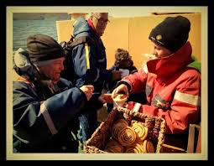
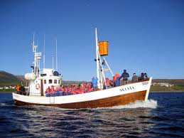
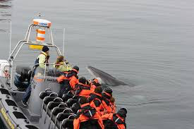
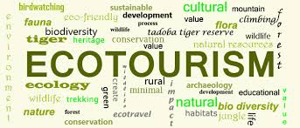
Kombinasjoner av verdier er unike

Slide 15
A value-based fingerprint
Alpha: the ‘green’ whale-watching company (their main concern is for environmental sustainability),
Beta: the sailors (their concern is for cultural heritage, restoring boats and sailing),
Gamma: the family of fishermen (their concern is for Icelandic coastal fishing culture and family heritage) and
Delta: the environmental researchers (their concern is for knowledge development and conservation).
Each company addresses other concerns as well, but these are less dominant in their innovation choices.

Slide 16
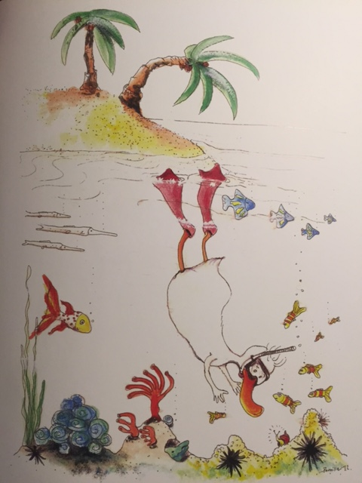
Takk!
Experiences are the only things that can make life longer
Illustration by Pernilla Lindroos

